Slide 1
SITEMAP (Phase I)
BASE-AM.COM
BASE-AM.COM.HK
BASE-AM.HK
Landing Page
Home
About BASE
Insights
Contact
Disclaimers
Mission Statement
“The Differentiator”
The Differentiator
Media Posts
LinkedIn, Twitter
Form
Privacy Statement
Investment Philosophy
Summary
Investment Philosophy
Cookie Policy
Media Posts
Summary
Investment Process
Terms and Conditions
Our Team
Definition of Professional Investor

Slide 2
SITEMAP (Phase II)
BASE-AM.COM
BASE-AM.COM.HK
BASE-AM.HK
Landing Page
New Section
Home
About BASE
Insights
Contact
Disclaimers
Subscribe / Login
Mission Statement
“The Differentiator”
The Differentiator
Media Posts
LinkedIn, Twitter
Form
Privacy Statement
Guest
Investment Philosophy
Summary
Investment Philosophy
Cookie Policy
Investor
Media Posts
Summary
Investment Process
Terms and Conditions
Our Team
Definition of Professional Investor

Slide 3

Website Layout Overview
Logo
Menu bar
(dropdown)
Language bar
(dropdown)
Menu bar (dropdown)
About BASE
The Differentiator
Investment Philosophy
Investment Process
Our Team
Insights
Contact
Language Menu bar (dropdown)
English
Chinese (traditional)
Chinese (simplified)
Reference:
Body Area
Disclaimers Menu
Social Media
Disclaimers Menu
Privacy Statement | Cookie Policy | Terms & Conditions
Social Media
Twitter, LinkedIn
Copyright
Email
Disclaimers
Copyright
Copyright © 2022 Base Asset Management Limited. All rights reserved.
constant
Email
info@base-am.com
Disclaimers
Refer “Website Wordings”

Slide 4
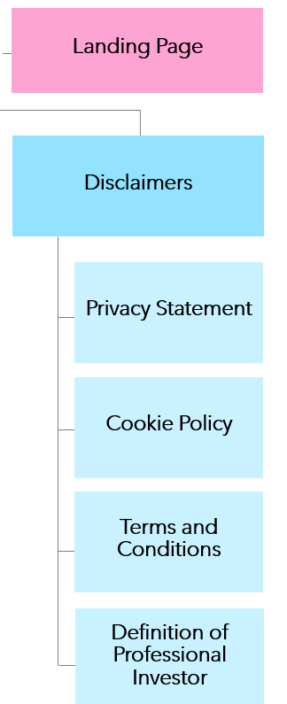
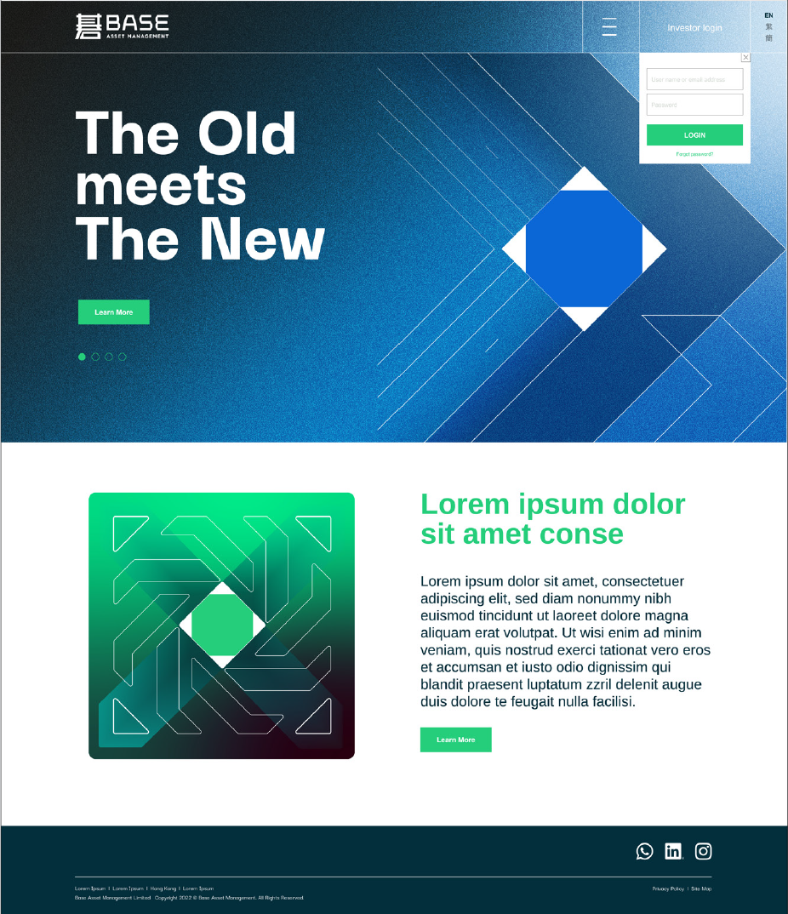

Landing Page – 2
Not yet ‘Accept’
Click links
Important Notice
(Refer “Website Wordings”)
Click links
To HOME
Refer “Website Wordings”
Accept
Decline
Cookie pop-up
‘Refresh’, click logo/other links (header/footer) => To ‘Important Notice’ pop-up
Accept
Reject
Customise

Slide 5
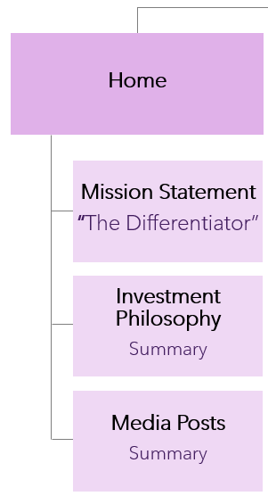
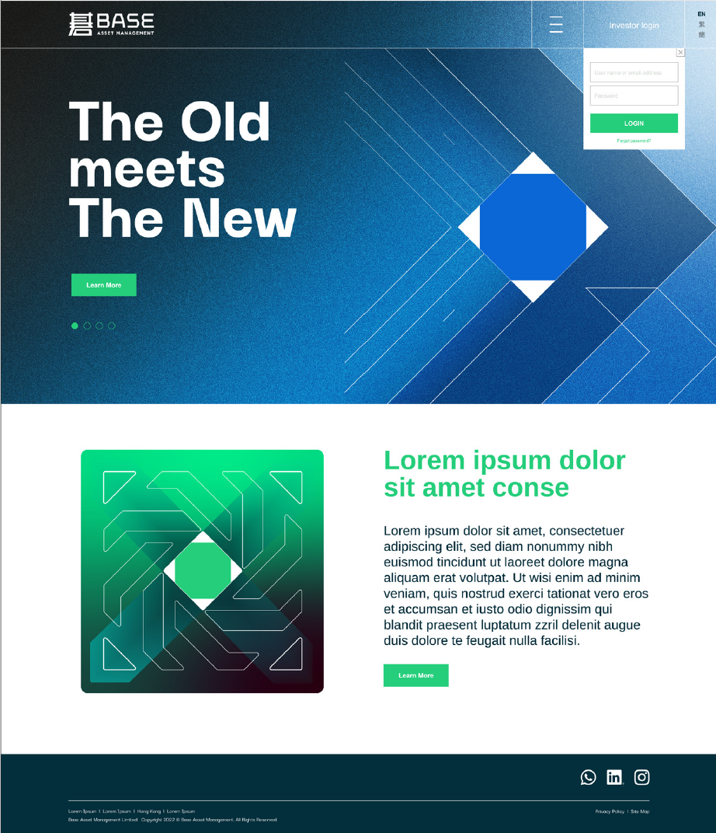



Home
Body Area
Leave No Stone
Unturned
‘Flipping Stone’ interactive / animated graphics
Summary
(Refer “Website Wordings”)
Explore >
To The Differentiator
Investment Philosophy
Summary
(Refer “Website Wordings”)
Learn more >
To Investment Philosophy
Insights
Summary
(Refer “Website Wordings”)
Click on the image -> to Insights
Click on the icon -> to Social Media links
View all >
To Insights

Slide 6
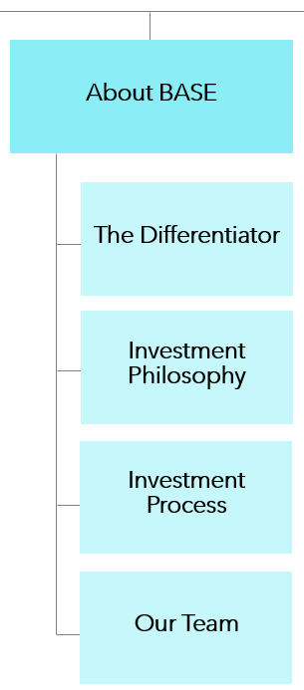

About BASE
Body Area
About BASE > The Differentiator
The Old
meets
The New
The Differentiator
(Refer “Website Wordings”)
See Investment Philosophy >

Slide 7
About BASE
Body Area
About BASE > Investment Philosophy
Discipline is the bridge between Goals and Accomplishment.
by Jim Ron
Investment Philosophy
(Refer “Website Wordings”)
See Investment Process >

Slide 8

About BASE
Body Area
About BASE > Investment Process
Strike While the Iron is Hot
Investment Process
(Refer “Website Wordings”)
Meet Our Team >

Slide 9
About BASE
Body Area
About BASE > Our Team
Focused.
Dedicated.
Open-minded.
Our Team
(Refer “Website Wordings”)
See The Differentiator >

Slide 10
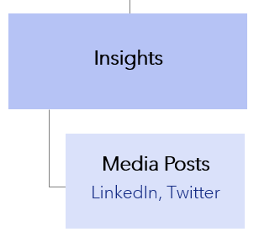

Insights
Body Area
Insights

Slide 11
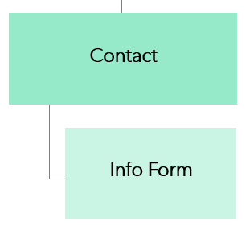
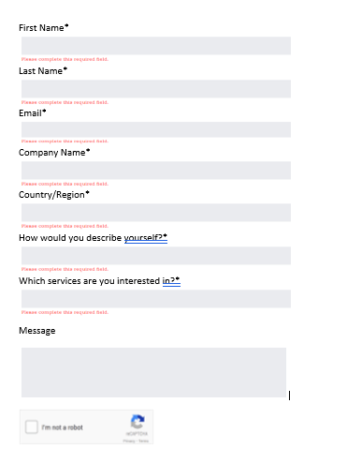
Contact
Body Area
Contact
(Refer “Website Wordings”)
Dropdown
Dropdown
Dropdown
Submit >

Slide 12
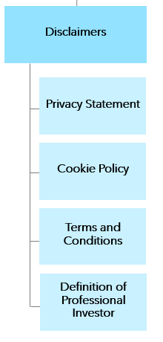
Disclaimers
Body Area
Disclaimers > Privacy Statement
Privacy Statement
(Refer “Website Wordings”)
Pop-up window over current viewing page

Slide 13
Disclaimers
Body Area
Disclaimers > Cookie Policy
Cookie Policy
(Refer “Website Wordings”)
Pop-up window over current viewing page

Slide 14
Disclaimers
Body Area
Disclaimers > Terms and Conditions
Terms and Conditions
(Refer “Website Wordings”)
Pop-up window over current viewing page

Slide 15
Disclaimers
Body Area
Disclaimers > Definition of Professional Investor
Definition of Professional Investor
(Refer “Website Wordings”)
Pop-up window over current viewing page

